Slide 1
Japanese Customs & Social Taboos

Slide 2
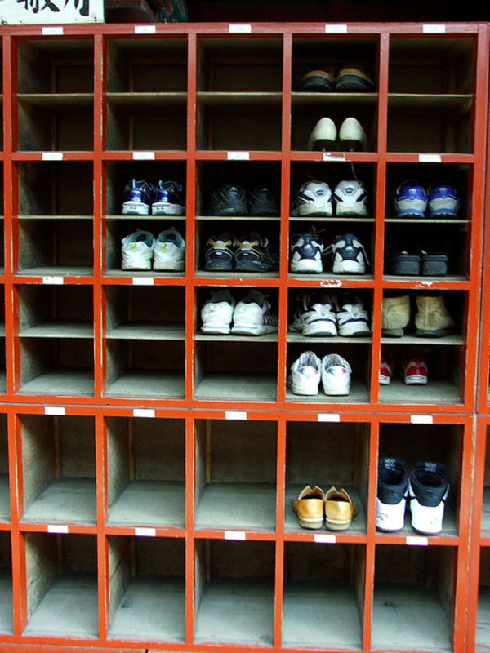
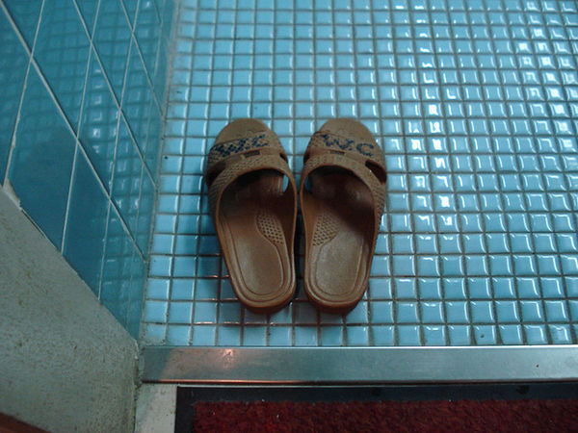
Take shoes off
Japanese never worn shoes in someone's home or on Japanese traditional flooring (tatami mats).
It is expected to take your shoes off in a restaurant, hotel, hot spring resort or in other places.
Usually they provide a place to put your shoes
Why?
In old times, Japanese had a custom of eating meals sitting on tatami mats (old times) and not on chairs. In addition, they rolled out the futon on which they sleep on the tatami floor. Therefore, they take their shoes off when entering the house to avoid bringing the dirty and germs from outside.
There are often different slippers for the bathroom.
Never wear the normal slippers into the bathroom (if slippers are provided).
Never wear the bathroom slippers outside of the bathroom.
It's easy to forget to take these off as you leave the bathroom, and this mistake is considered embarrassing.

Slide 3
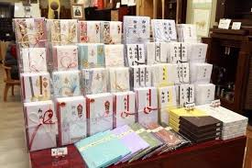
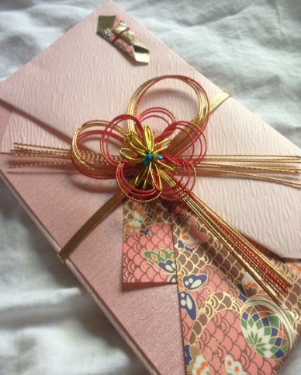
Gift-Giving customs
is deeply rooted in tradition, not only for social occasions, but also for social obligations such as business.
gifts are given on anniversaries, weddings, births, graduations, and so on. Children's achievements are also celebrated with gifts, usually with money in envelopes.
Companies spend large sums of money on gifts to their clients and customers
Different types of gifts are given on different occasions (ochugen and oseibo), common for co-workers, friends and relatives to exchange gifts. Also to their superior at work.

Slide 4
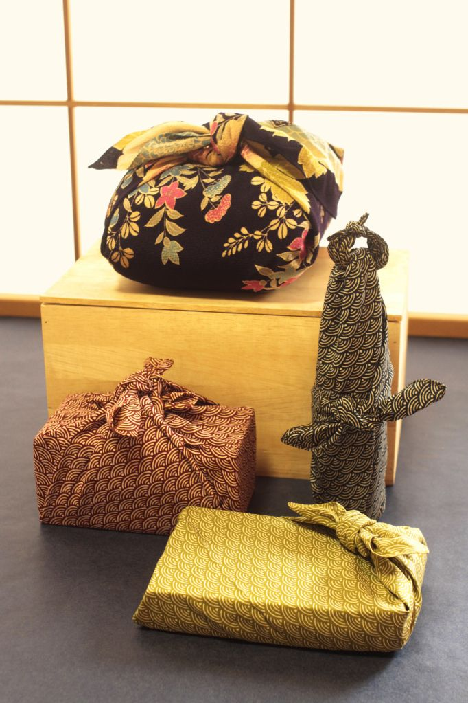
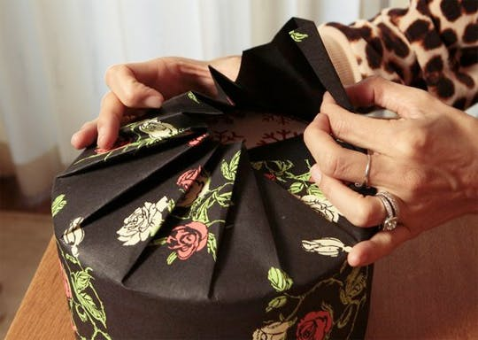
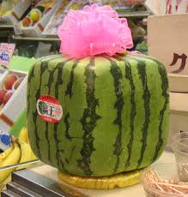
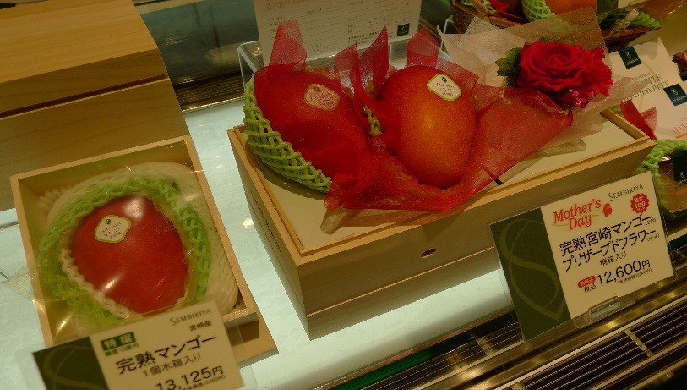
Gift Wrapping
Japanese relate to "wrapping the heart”, so gift is marked by thoughtfulness and consideration.
The value of the gift is of less importance, much attention is given to the wrapping of presents.
It is not just a paper bag and adhesive bows. It can be a real art, from a piece of paper to the Japanese craft of “furoshiki” (traditional Japanese wrapping-cloth).
It is a form of art that can be made in the most beauty appearance, and it can wrap everything in all kind of shapes and forms that you can image

Slide 5
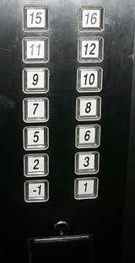
Number 4 avoided
Number 4 is avoided because it sounds like the word death (shi, 死）
24 can become nishi, double death (nishi, 二死）
42 can be shini, meaning death (shini, 死に) – also consider the “yakudoshi” (unlucky age for men)
43 can become shisan, sounds like stillbirth ( shizan, 死産）
45 can be shigo, or after death (shigo, 死後）
Elevators will often missing the 4th floor

